Slide 1
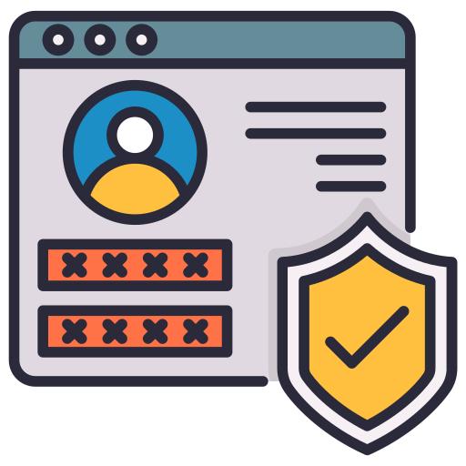
Security Principle 2: Privilege Management
Verifying identity in the digital world

Slide 2
What is Privilege Management?
Privilege Management: a method of governing access to resources by permitted authorised users
When a user tries to access a resource, they will be checked if they are allowed to have this access. If they are, they can access it. If not, they’ll be denied.

Slide 3
Why does Privilege Management matter?
Privilege Management matters because it ensures that only authorised users can access the appropriate resources.
Limiting the number of users who have access to resources increases system security because it ensures users have access to necessities only where they can still operate to accomplish their tasks (Joint Task Force, 2020).
  Verizon’s 2024 Data Breach Investigations report found that 40% of data breaches involved privileged accounts (Verizon, 2024).
  Organisations must apply to each user the appropriate privilege level based on their role, and ensure no one exploits their current privilege level, whether necessary or not.
Let's see what happens when privilege management fails in Ubuntu and AWS, and how to fix it.

Slide 4
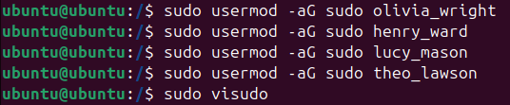
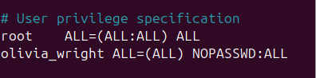
Initial Linux Vulnerable Setup
Sudo access – grants the user the ability to run commands as root. The root is a powerful user as they are allowed to perform the following (www.ssh.com, n.d.):
  Configure network settings
  Install system applications
  Change permissions and contents of files
NOPASSWD rule – removes password authentication of Administration department member Olivia Wright inside the visudo file. Allows Olivia to execute root commands whenever she wants without verification.
The other 3 members are granted the ability to run commands as root, as they are members of the IT team. They are responsible for securing the IT infrastructure.
Figure 1: Olivia Wright and the 3 members of the IT team granted Sudo access by being added to group named “sudo”. File “visudo” is about to be opened
Figure 2: Olivia Wright implementing the NOPASSWD to herself

Slide 5
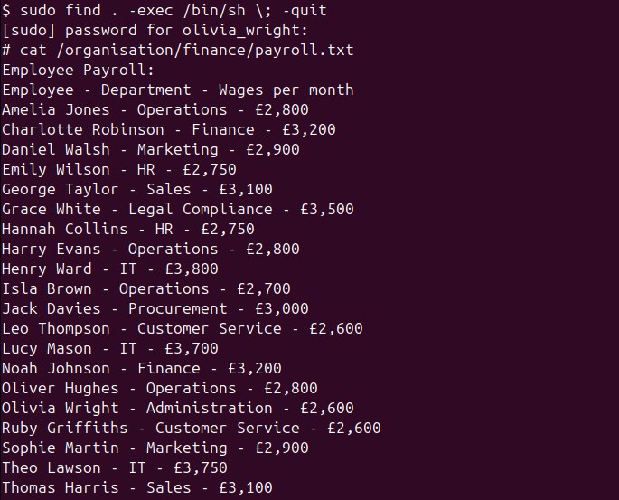

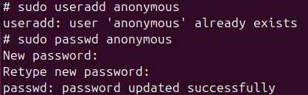
Linux Exploitation Process
“sudo find . –exec /bin/sh ; -quit” – command allows Olivia to abuse the “find” tool, which Olivia can run as root to open a root shell
This gives her unrestricted control over the entire system.
Obtaining organisation’s information – below the command, she uses the “cat” command to view the contents of the payroll.txt file inside the finance department’s folder.
Having access to financial records can reveal info such as income, tax and account details. Data can enable identity theft and financial abuse.
Adjusting account settings of organisations – Olivia writes “sudo passwd noah_johnson” to change the password of employee Noah Johnson without him knowing.
She then dares to add herself as an “anonymous”, an extra account that shouldn’t be part of the system.
Only employees, accompanied by their real names as usernames, should exist within the system
Figure 3: Olivia Wright abusing the “find” tool and obtaining the income of her fellow employees in the payroll.txt file
Figure 4&5: Olivia Wright changing Noah Johnson’ password and adding an anonymous account

Slide 6
Why did the exploitation work?
The exploitation worked because a member of the business was allowed an additional privilege operation she was not meant to have at all.
  Olivia Wright is a member of the Administration department; she’s meant to be in charge of overseeing all of its daily operations. She makes sure every employee is doing their job correctly.
  Henry Ward, Lucy Mason and Theo Lawson are the 3 members of the IT team. It should be only their job to configure network systems and implement the privilege management themselves.
  These operations link to their role of ensuring the organisation’s IT structure is correctly implemented.
There was a lack of review of assigned user privileges to determine if they were necessary for each employee to ensure they had the necessary privileges to complete their tasks. This should be done periodically.
An over-privileged account can compromise the confidentiality, integrity and accessibility of a business’s system.
Internal threats: sometimes employees themselves attack a system, not just hackers. Intentionally or accidentally, they can threaten the system by mishandling confidential data or inserting malware onto the network.
  Verizon’s 2024 Data Breach Investigations report found that 19% of breaches involved internal actors (Swif.ai, 2026).

Slide 7


Solutions for preventing exploitation: Correcting the initial exploitation
Remove extra privilege access from Olivia – using “sudo gpasswd –d {username} {name of group}” command, Olivia Wright was removed from the “sudo” group.
  Being part of it is what allowed her to have root access
NOPASSWD policy removed – Performed in the “visudo” file to ensure protection and authorised access of systems by making sure employees have to verify their identity.
Verification of who has privileged access “getent group sudo” shows that only the 3 IT employees have root access, as it should.
Figure 6: Olivia Wright has root access revoked from her
Figure 7: Olivia Wright has NOPASSWD policy in “visudo” file removed
Figure 8: Verification that only the IT employees can have root access
Notes:
Canonical (2019). Ubuntu Manpage: pam_pwquality - PAM module to perform password quality checking. [online] Ubuntu.com. Available at: https://manpages.ubuntu.com/manpages/jammy/man8/pam_pwquality.8.html.

Slide 8
Solutions for preventing exploitation: Practices within the work environment
Periodic Reviews of assigned user privileges for each employee to determine if they have the necessary amount to perform their respective operations (Joint Task Force, 2020).
If unnecessary permission is identified, remove that error immediately.
The rights of accessing resources should be determined based on what is needed to perform their roles.
Investigate and properly assess any attempts by unauthorised users or devices to connect to the system, to identify how it has occurred and mitigate the access point.
Test access using user accounts to verify that permissions match job responsibilities.
Additional NCSC Guidance (www.ncsc.gov.uk, n.d.):
  Justify administration intent: You should be able to explain why you’ve set permissions as they’ve been set to gain approval and deter malicious insiders.
  Use appropriate approvals: Carefully consider the request by referring to the approval rules that govern access to your systems and data.

Slide 9
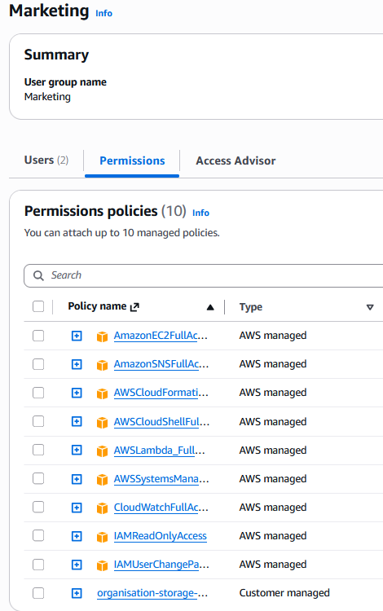
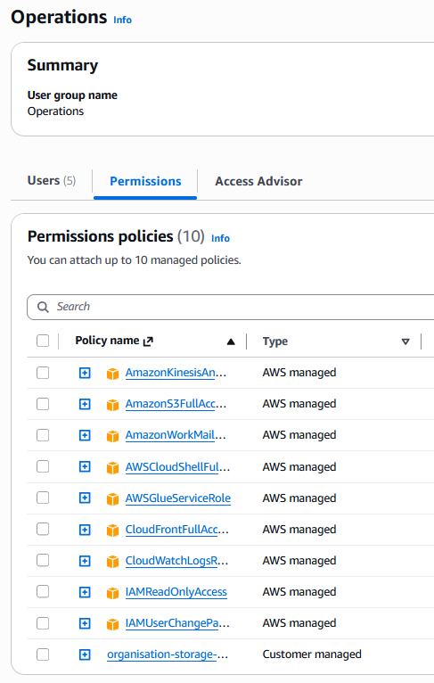
Initial AWS Vulnerable Setup
In AWS, Identity Access Management (IAM) is used to “manage and scale workload and workforce securely supporting your agility.” (Amazon Web Services, 2024)
It is where you assign users and groups their “permissions policies”, which define the permissions employees have in the system.
As shown in Fig. 9, both the Marketing and Operations groups have policies attached so they can perform their respective operations.
However, these policies have been assigned incorrectly…
Figure 9: Marketing and Operations groups have both of their permissions being mixed up the wrong way round.

Slide 10
What is wrong with the mistake?
These policies were assigned incorrectly because they were mixed up.
This means that both the Operations and Marketing departments won’t be able to perform their correct operations.
This would hold back a list of roles to be performed behind and increase pressure and workload on the employees of the departments.
There was a lack of review of assigned user privileges to determine if each department had the correct policies to ensure they had the necessary privileges to complete their tasks.

Slide 11
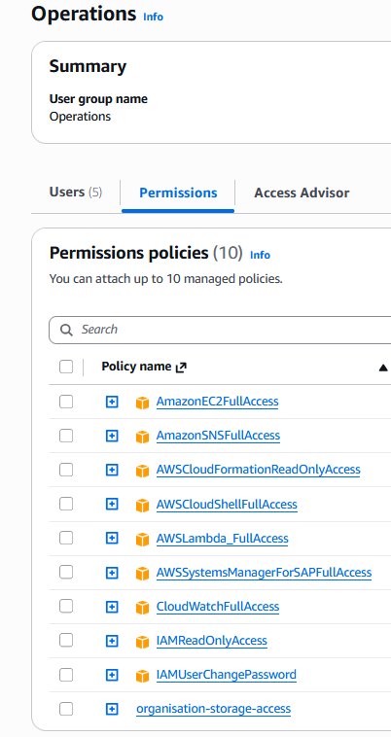
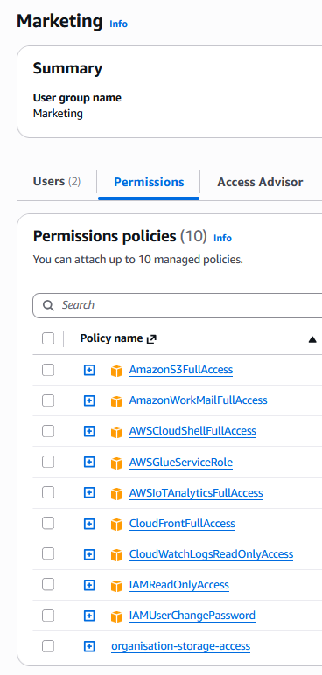
Solutions for preventing exploitation: Practices within the work environment
Fixing the actual mistake: Simple, just swap the policies attached between both department groups so that they can perform their operations.
Also, make sure you haven’t overprivileged any users or departments; this can also compromise the system or carry risk of insider threats like Ubuntu.
Practices within the work environment:
  Test access using user accounts to verify that permissions match job responsibilities.
  Periodic Reviews of assigned user privileges for each employee to determine if they have the necessary amount to perform their respective operations (Joint Task Force, 2020).
  If unnecessary permission is identified, remove that error immediately.
Figure 10: Operations and Marketing policies correctly attached

Slide 12
Summary
Privilege Management is the management of access to resources by permitted authorised users based on their responsibilities.
It can be implemented incorrectly by giving users incorrect privileges or over-privileges that are completely unnecessary.
Using Ubuntu, we discovered that over-privileges could compromise the confidentiality, integrity and accessibility of a business’s system.
In AWS, we discovered that department functions and users can be disrupted if not assigned the correct policies.
Also ensure that you have justifiably assigned the correct necessary privileges for each department and user.
If you are unsure, perform trials to verify that the permissions are set correctly.
If you spot any errors, remove them with immediate effect.

Slide 13
References
Joint Task Force (2020). Security and Privacy Controls for Information Systems and Organizations. Security and Privacy Controls for Information Systems and Organizations, [online] 5(5). doi:https://doi.org/10.6028/nist.sp.800-53r5.
Verizon (2024). 2024 Data Breach Investigations Report. [online] Verizon Enterprise Solutions. Available at: https://www.verizon.com/business/resources/reports/2024-dbir-data-breach-investigations-report.pdf.
www.ssh.com. (n.d.). What is a Root User Account? How to Root Phones? [online] Available at: https://www.ssh.com/academy/pam/root-user-account.
Swif.ai. (2026). Available at: https://www.swif.ai/blog/insider-threat-cyber-security-statistics.
www.ncsc.gov.uk. (n.d.). Use privileged access management. [online] Available at: https://www.ncsc.gov.uk/collection/secure-system-administration/use-privileged-access-management.
Amazon Web Services (2024). AWS Identity & Access Management. [online] Amazon Web Services, Inc. Available at: https://aws.amazon.com/iam/.

